Slide 1
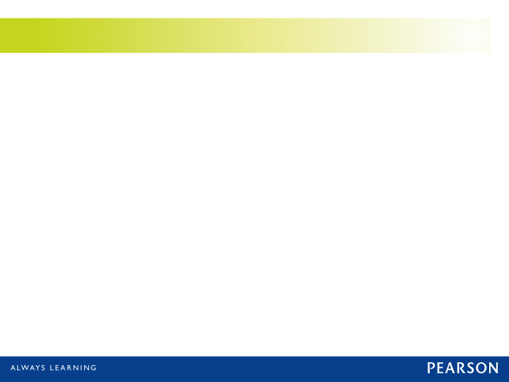

Tech Stack Boot Camp
Day 1
REST, RestExpress, Eventing & SubPub

Slide 2

A Little About Me
Todd Fredrich
Product Architect
Pearson eCollege
Java guy since 1998…
C/C++ before that
10+ years of services experience
SOAP over JMS anyone?
Axis/Axis2
4+ years REST-ish experience

Slide 3
REST
http://www.RestApiTutorial.com

Slide 4

Quick Overview of REST
REST == “REpresentational State Transfer”
Simply and architectural style (Roy T. Fielding)
Embraces the web as it was meant to be used
Resource-based
Representations
Six constraints:
Uniform interface
Stateless
Client-server
Cacheable
Layered system
Code on demand

Slide 5
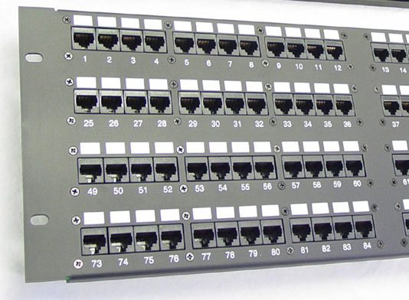
Uniform Interface
Identification of resources
Resource manipulation via representations
Hypermedia as the engine of application state (HATEOAS)
Self-descriptive messages

Slide 6
Identification of Resources
Identified by URIs
Multiple URIs may refer to same resource.
Naming URIs is key to usability [BEST PRACTICE]
Nouns vs. verbs (things vs. actions)
For example:
http://example.com/customers/42
http://example.com/customers/42/orders
http://example.com/customers/42/orders/33
http://example.com/processes/annual-tax-increase/2012

Slide 7
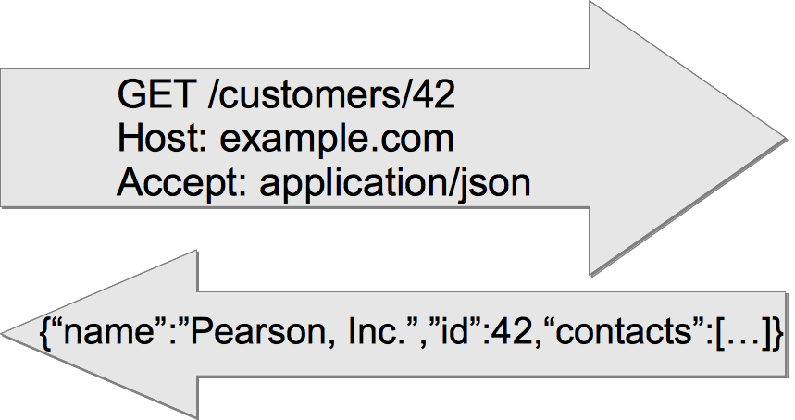
Resource Manipulation via Representations
Part of the resource state
Transferred between client and server
Typically JSON (historically XML)

Slide 8
Hypermedia As The Engine Of Application State (HATEOAS)
More advanced model
Recommend at a minimum, Location header on create:
Location: http://example.com/customers/43
Example “Order”:
{“id”:33,”items_sold”:3,”customer”:{”href”:”http://example.com/customers/42”},
“links”:[
{“rel”:”self”, ”href”: ”http://example.com/customers/42/orders/33”},
{“rel”:”related”,”title”:”order line-items”,”href”:”http://example.com/customers/32/orders/33/line-items”}
]}

Slide 9

Self-Descriptive Messages
Visibility due to:
Standard HTTP methods
Understandable resource names (URIs)
Control data (HTTP headers)
Media Types & negotiations
Returned data (representations)

Slide 10
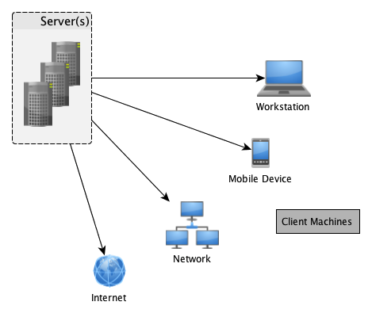
Stateless
Server contains no client state
Each request contains enough context to process the message
Self-descriptive messages
Any session state is held on the client
Client-Server
Assume a disconnected system
Separation of concerns
Uniform interface links the two

Slide 11
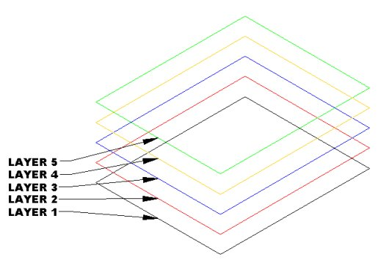
Cacheable
Server responses (representations) are cacheable
Implicitly
Explicitly
Negotiated
Layered System
Client can’t assume direct connection to server
Software or hardware intermediaries may exist between client and server
Improves scalability

Slide 12

Code on Demand
Server can temporarily extend client
Transfer logic to client
Client executes logic
For example:
Java applets
Executable JavaScript
The only optional constraint

Slide 13

Before REST (e.g. SOAP-RPC)
Customer Management Service
addNewCustomer()
getCustomerList()
getCustomerInfo()
updateCustomer()
deleteCustomer()
Order Management Service
createOrder()
updateOrder()
getOrderList()
getOrderInfo()
cancelOrder()
addOrderItem()
removeOrderItem()

Slide 14
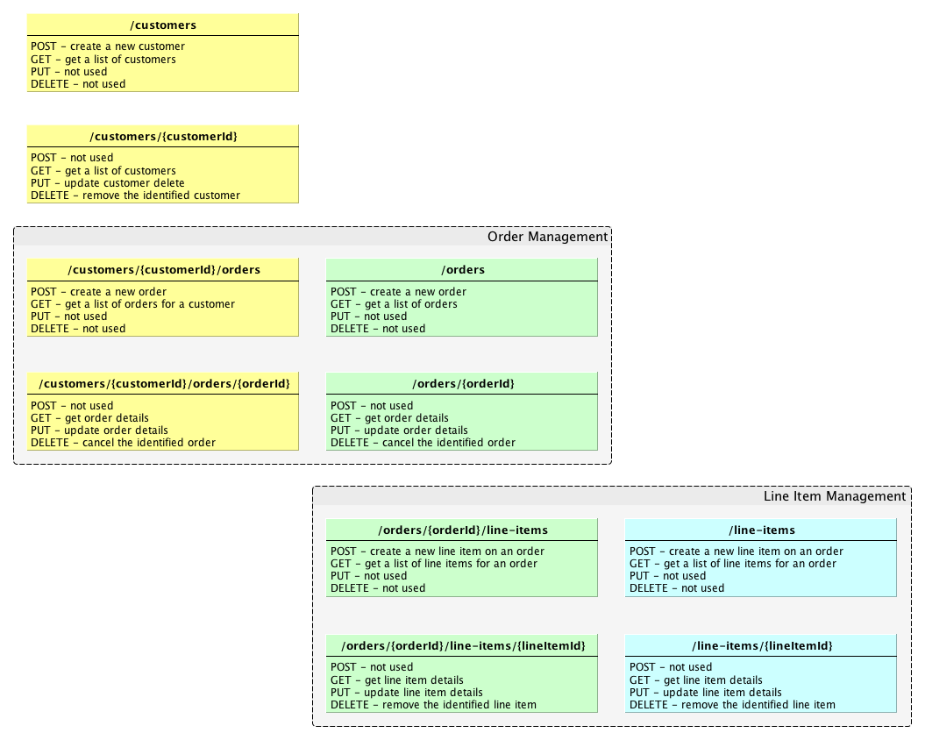


Slide 15
REST API Best Practices
Use HTTP verbs to mean something
GET (read)
PUT (update)
DELETE (uh… delete/remove)
POST (create, plus others)
OPTIONS (for documentation)
Sensible, hierarchical resource names (nouns only)
Return JSON (also support XML)
Fine-grained resources (with CRUD, if applicable)
Support caching (via returned HTTP headers)
Support pagination (limit, offset, with sensible limit default)
Embrace connectedness (HATEOAS)
Location headers on create (minimal)
See http://www.RestApiTutorial.com Best Practices Guide

Slide 16

RestExpress
https://github.com/RestExpress/RestExpress

Slide 17








What is RestExpress?
Simplest thing that could possibly work…
Java-based REST framework
For JSON & XML CRUD-style services
Uses Netty NIO framework as its HTTP server
Convention over configuration
ISO8601 time point handling in JSON/XML

Slide 18
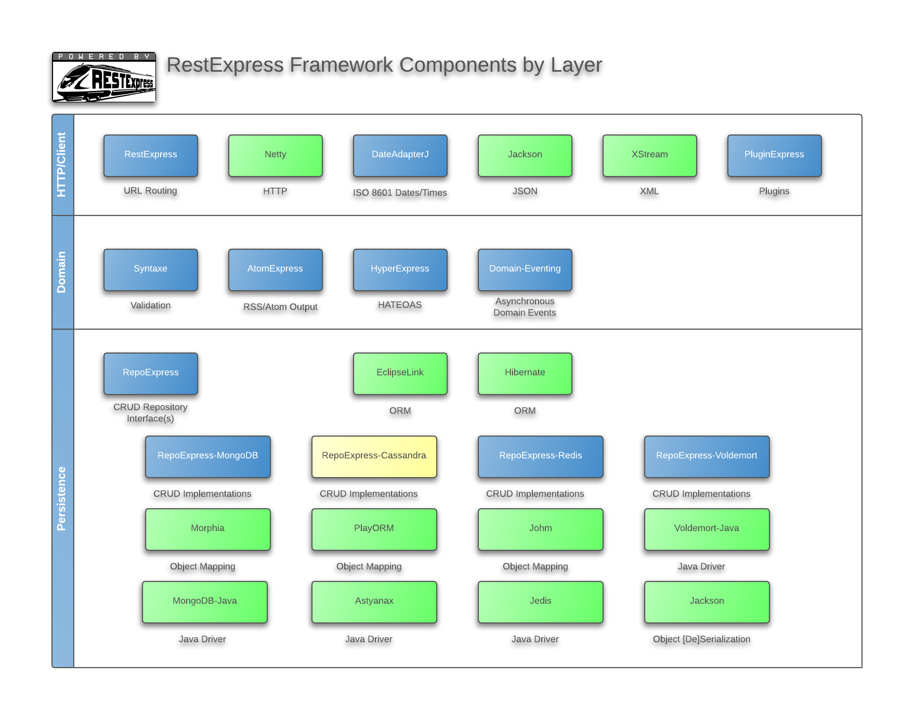

Slide 19
A Minimal RestExpress Server
public class Echo {
public static void main(String[] args) {
RestExpress server = new RestExpress();
server.uri("/echo", new Object() {
public String read(Request request, Response response) {
String value = request.getRawHeader("echo");
response.setContentType("text/xml");
if (value == null) {
return "<echo><error>no value specified</error></echo>";
}
else {
return String.format("<echo><value>%s</value></echo>", value);
}
}
})
.method(HttpMethod.GET)
.noSerialization();
server.bind(8000);
server.awaitShutdown();
}
}

Slide 20

Our Project: Little-LMS
Everyone here knows the domain
New technology stack is hard enough
3 domain objects: Student, Course, Enrollment
CRUD in MongoDB
Domain validation (“requiredness”)
Error handling (proper HTTP statuses)
Caching support
Location header on create
Pagination
Sorting & filtering

Slide 21
Phase 1: Courses
Domain object: Course
ID (is supplied by AbsractLinkableEntity)
Name, required
Description
Routes:
POST /courses.{format}
GET, PUT, DELETE /courses/{courseId}.{format}

Slide 22
Let’s Do It!

Slide 23

Starting a Project
Getting Started Guide:
http://githubenterprise.pearson.com/openclass-gettingstarted/Getting-Started-Guide
Maven settings.xml file
Normally: MongoDB Scaffolding Project
http://githubenterprise.pearson.com/openclass-gettingstarted/RestExpress-Scaffold
mvn archetype:generate –DarchetypeCatalog=local

Slide 24
Touch Points
Create Routes (Routes.java)
Create a Controller (e.g. CourseController.java)
Create a Service (e.g. CourseService.java)
Create a Repository (e.g. MongodbCourseRepository.java)
Add Configuration.java (stitch repository, controller, service)
“getter” for controller

Slide 25
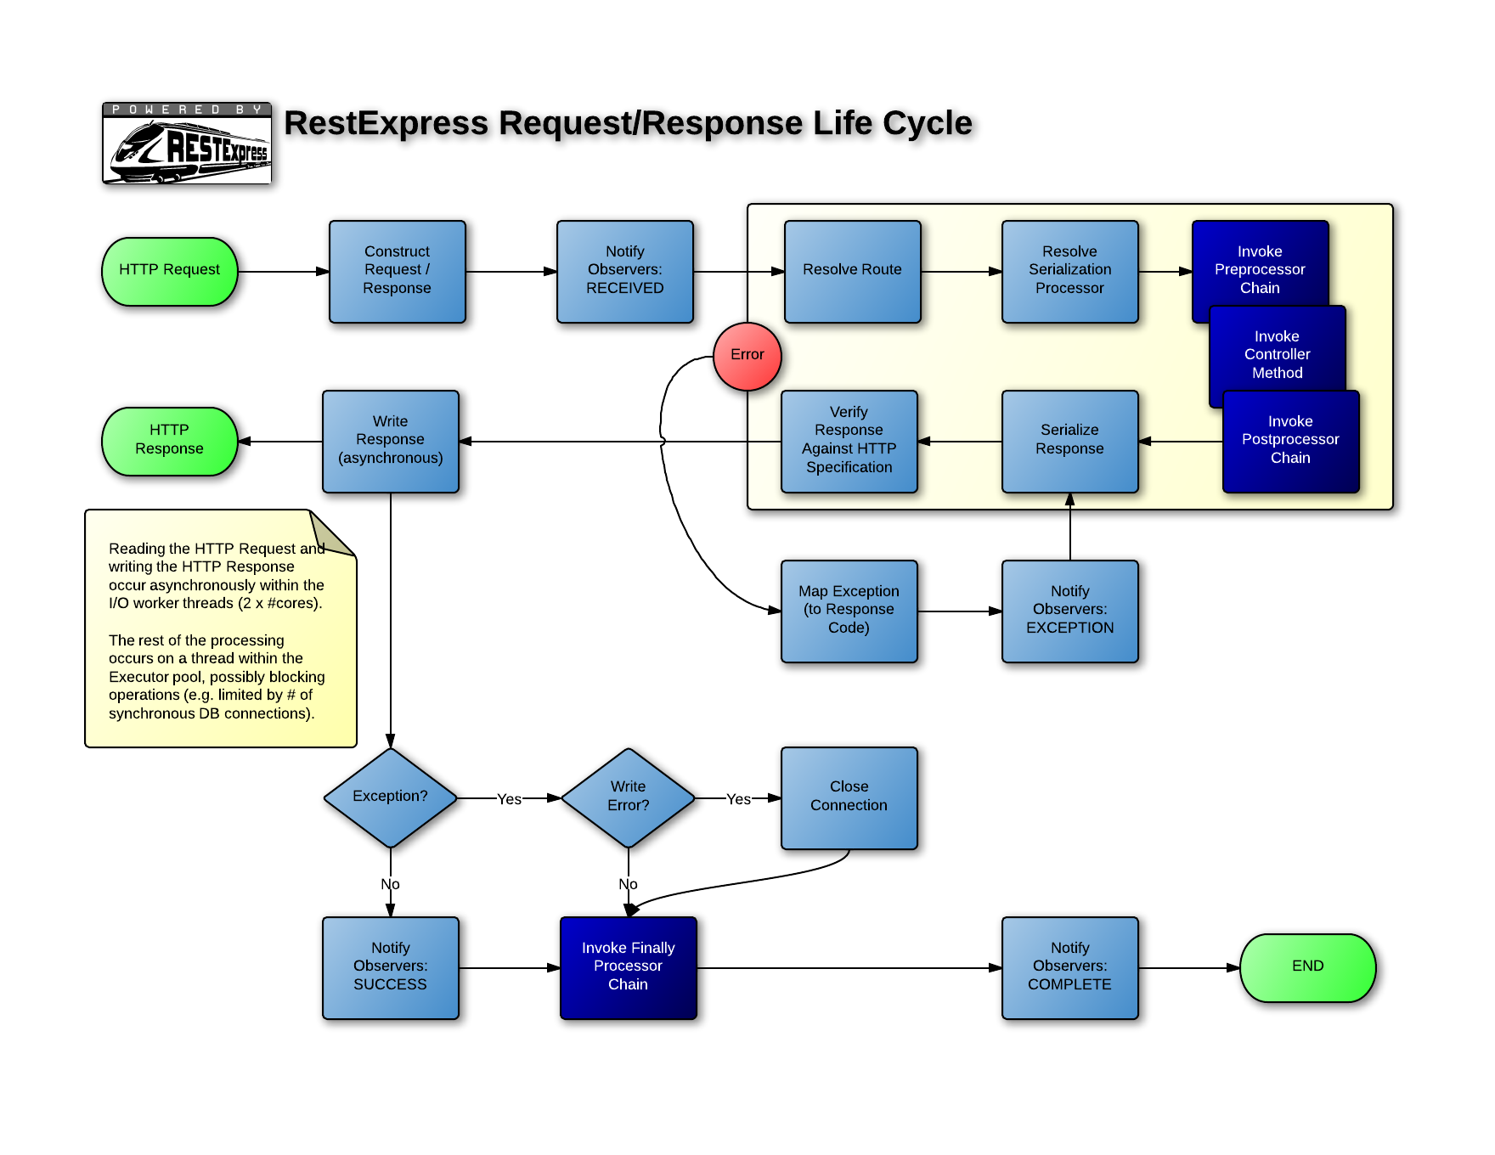

Slide 26
MongoDB and RestExpress
Using RepoExpress

Slide 27
RestExpress is DB Agnostic
Can use any persistence technology
RepoExpress implements Repository pattern
public interface Repository<T extends Identifiable>
{
public T create(T object);
public void delete(String id);
public void delete(T object);
public boolean exists(String id);
public T read(String id);
public List<T> readList(Collection<String> ids);
public T update(T object);
}

Slide 28
RepoExpress Queryable Interface
Some repositories are ‘enhanced’ (MongoDB in particular)
public interface Queryable<T extends Identifiable>
{
public long count(QueryFilter filter);
public List<T> readAll(QueryFilter filter, QueryRange range,
QueryOrder order);
}

Slide 29
ObservableRepository
An observer lets us “get in the game” as persistence operations occur…
public interface RepositoryObserver<T extends Identifiable>
{
public void afterCreate(T object);
public void afterDelete(T object);
public void afterRead(T object);
public void afterUpdate(T object);
public void beforeCreate(T object);
public void beforeDelete(T object);
public void beforeRead(String id);
public void beforeUpdate(T object);
}

Slide 30
Two Types of MongoDB Repositories
MongodbEntityRepository
Uses Mongo’s own ObjectId type as ID
Persistence operations on AbstractMongodbEntity instances
Sets ‘createdAt’ and ‘updatedAt’
Observable
MongodbRepository
Uses object-supplied ID
Supply your own ID adapter (if other than String)
Persistence operations on Identifiable instances (recommend extending AbstractTimestampedIdentifiable)
Observable

Slide 31
Phase 2: Students
Domain object: Student
ID (supplied by AbstractLinkableEntity)
Name, required
Major
Routes:
POST /students.{format}
GET, PUT, DELETE /students/{studentId}.{format}

Slide 32
Let’s Do It!

Slide 33
Touch Points
Create Routes (Routes.java)
Create a Controller (e.g. StudentController.java)
Create a Service (e.g. StudentService.java)
Create a Repository (e.g. MongodbStudentRepository.java)
Add Configuration.java (stitch repository, controller, service)
“getter” for controller

Slide 34
Domain Validation
Using Syntaxe

Slide 35
Syntaxe is an Annotations-Based Validation Framework
Annotate Fields
@StringValidation(name,required,minLength,maxLength)
@IntegerValidation(name,min,max)
@RegexValidation(name,pattern,nullable,message)
@FieldValidation(Validator extender class)
Annotate Classes
@ObjectValidation(Validitator extender class)
Class Inheritence
Validatable interface
validate() throws ValidationException(List<String) on error.
ValidationEngine.validate(Object)
ValidationEngine.validateAndThrow(Object)

Slide 36
SubPub

Slide 37
What is SubPub?
Messaging Infrastructure
Based on RabbitMQ
HTTP interface (POST)
“At Least Once” guarantee semantics
Supports:
Pub/sub
Request/reply
Fine and course-grained subscription options
Based on ‘context tags’
Ignores payload
See: http://code.pearson.com (search for ‘prospero’)
Prospero Integration Guide

Slide 38
Publishing via SubPub
SubPub-java (driver)
http://githubenterprise.pearson.com/FREDTA2/subpub-java
SubPubMessageBus.publish(Message);
Implementation additions:
Add Configuration.getMessageBus();
MessageFactory.getInstance().toMessage(Object)
Taggable interface
See: SubPub-Publisher
http://githubenterprise.pearson.com/openclass-gettingstarted/RestExpress-Publisher

Slide 39
Subscribing to SubPub Messages
SubPub-java (driver)
RestExpress Plugin:
SubPubSubscriptionPlugin
http://githubenterprise.pearson.com/FREDTA2/RestExpress-SubPub-Plugin
Extend SubPubDeliveryHandler
Implement getMessageType()
[optional] Implement getContextTags()
Implement handle(Delivery)
See: RestExpress-Subscriber
http://githubenterprise.pearson.com/openclass-gettingstarted/RestExpress-Subscriber

Slide 40
Advanced RestExpress
Pagination, Filtering, Sorting and Other Goodies

Slide 41
Pagination Support
Best practices:
Query-string parameters, limit and offset
Or Range header (e.g. ‘Range: items=0-19’)
Response header: Content-Range: 0-19/50
QueryRanges and QueryRange classes
QueryRanges.parseFrom(Request r)
QueryRanges.parseFrom(Request r, int limit)
QueryRange.asContentRange(int count)

Slide 42
Filtering Support
Best practices:
Query-string parameter, “filter”
Name/value separator, double colons (“::”)
Pair separator, verticle bar (“|”)
Example:
…/customers?filter=city::Denver|country::USA
QueryFilters and QueryFilter Classes
QueryFilters.parseFrom(Request r)
QueryFilter.hasFilters()
QueryFilter.iterate(FilterCallback c)
FilterCallback Interface
filterOn(FilterComponent c)

Slide 43
Sorting/Ordering Support
Best practices:
Query-string parameter, “sort”
Implied order is ‘ascending’
Descending indicator is a prefix dash (“-”)
sort separator, verticle bar (“|”)
Example:
…/orders?sort=customer_name|-total
QueryOrder Class
QueryOrder.parseFrom(Request r)
QueryFilter.isSorted()
QueryFilter.iterate(OrderCallback c)
OrderCallback Interface
orderBy(OrderComponent c)

Slide 44
Error Handling
RestExpress uses RuntimeException
server.mapException(from<Throwable>, to<ServiceException>)
Mapping Exceptions to HTTP Statuses
ServiceException → 500
BadRequestException → 400
ConflictException → 409
ForbiddenException → 403
HttpSpecificationException → 500
MethodNotAllowedException → 405
NotFoundException → 404
UnauthorizedException → 401
Need Another?
Extend ServiceException
Call super(<integer http status code>) in constructor.

Slide 45
Wrapped Responses
Why?
AJAX (browser) clients
Error conditions
What?
Wrap response data in envelope
JSEND
Success: {“status”:”success”,”code”:201,”data”:”<json>”}
Error: {“status”:”error”,”code”:400,”data”:”BadRequestException”, “message”:”Could not parse JSON input”}
Failure: {“status”:”fail”,”code”:500,”data”:”NullPointException”}
How?
server.putResponseProcessor(String format, ResponseProcesor rp)
ResultWrapper.fromResponse(Response r)

Slide 46
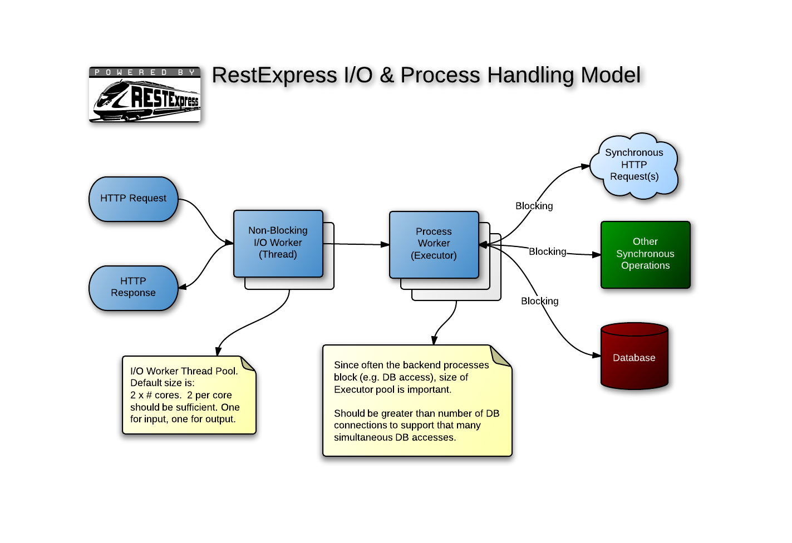

Slide 47
Phase 3: Enrollments
Domain object: Enrollment
ID, required (MongoDB ObjectId)
StudentId, required, must exist
CourseId, required, must exist
Routes:
GET /students/{studentId}/enrollments.{format}
POST, DELETE /students/{studentId}/enrollments/{courseId}.{format}
GET /courses/{courseId}/enrollments.{format}
POST, DELETE /courses/{courseId}/enrollments/{studentId}.{format}

Slide 48
Let’s Do It!

Slide 49
Touch Points
Create Routes (Routes.java)
Create a Controller (e.g. EnrollmentController.java)
Create a Service (e.g. EnrollmentService.java)
Create a Repository (e.g. MongodbEnrollmentRepository.java)
Add Configuration.java (stitch repository, controller, service)
“getter” for controller

Slide 50
HATEOAS
With HyperExpress

Slide 51
Hypermedia Linking (HyperExpress)
Classes
Link
LinkableObject – wrapper for class links
LinkableCollection – wrapper for collections
Interface
Linkable – defines the interface for LinkableObject and LinkableCollection
Helpers
LinkUtils
MapStringFormat

Slide 52
Let’s Do It!

Slide 53
RestExpress Stack Links
https://netty.io/
http://code.google.com/p/google-gson/
http://xstream.codehaus.org/
http://code.google.com/p/morphia/
https://github.com/mongodb/mongo-java-driver/downloads
https://github.com/RestExpress/Syntaxe
https://github.com/tfredrich/DateAdapterJ
https://github.com/tfredrich/Domain-Eventing
https://github.com/RestExpress/HyperExpress
https://github.com/RestExpress
https://github.com/RestExpress/RestExpress-Scaffold

Slide 54
Additional Resources:
REST API Design Rulebook, Mark Masse, 2011, O’Reilly Media, Inc.
RESTful Web Services, Leonard Richardson and Sam Ruby, 2008, O’Reilly Media, Inc.
RESTful Web Services Cookbook, Subbu Allamaraju, 2010, O’Reilly Media, Inc.
REST in Practice: Hypermedia and Systems Architecture, Jim Webber, et al., 2010, O’Reilly Media, Inc.
Service Design Patterns, Robert Daigneau, 2012, Pearson Education, Inc.
SOA with REST, Thomas Erl, et. al., 2013, SOA Systems Inc.
NoSQL Distilled, Pramod J. Sadalage and Martin Fowler, 2013, Pearson Education, Inc.
http://www.RestApiTutorial.com/
https://github.com/RestExpress/RestExpress/wiki

Slide 55
Title
Bullet

